Slide 1
Object Oriented Metrics

Slide 2
Object-Oriented Programming
OOP is a methodology for system analysis, design and implementation that supports integration of functional and data-oriented programming and system development.
Class | A class is a description of a set of objects that share the same attributes, operations, relationships, and semantics.
Object | An instantiation of some class which is able to save a state (information) and which offers a number of operations to examine or affect this state.
Attribute Variable | An attribute is a named property of a class that describes a range of values instances of the property may hold.
Operation Responsibility Method | An operation is the implementation of a service that can be requested from any object of the class to affect behaviour.

Slide 3
Object-Oriented Programming
Package | A package is a general purpose mechanism for organizing elements into groups. Packages group functionally related classes.
Cohesion | The degree to which the methods within a class or classes in a package are related to one another.
Coupling | Object X is coupled to object Y if and only if X sends a message to Y.
Association | A semantic relationship between two or more classes that specifies connections among their instances.
Inheritance | A relationship among classes, wherein an object in a class acquires characteristics from one or more other classes.

Slide 4
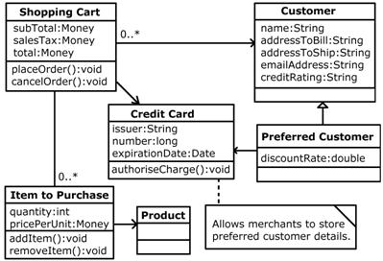
Class Diagram
Inheritance
Association

Slide 5
Similarities & Differences
Why Object-Oriented Software Engineering (OOSE) metrics are different from the conventional software metrics?
OOSE metrics are different because of:
Localization
Encapsulation
Information hiding
Inheritance
Reuse

Slide 6
Localization
Localization means placing items in close (physical) proximity to each other.
Functional decomposition (localize information around functions).
Object-oriented approaches (localize information around objects).
In conventional software engineering, localization is based on functionality. Therefore:
Metrics gathering has traditionally focused on functions and functionality
Units of software were set to be functional, thus metrics focusing on component relationships emphasized functional interrelationships, e.g., module coupling and cohesion.

Slide 7
Localization
In object-oriented software, however, localization is based on objects. This means:
Metrics identification and gathering effort must recognize the “object” as the basic unit of software.
Within systems of objects, the localization between functionality and objects is not a one-to-one relationship.
For example, one function may involve several objects, and one object may provide many functions.

Slide 8
Encapsulation
Encapsulation is the packaging (or binding together) of a collection of items:
Low-level examples of encapsulation include records and arrays, procedures.
OO programming languages allow higher-level encapsulating, e.g., classes in C++ and Java.
Encapsulation has two major impacts on metrics:
The basic unit will no longer be the program, but rather the object.
We have to modify our thinking on characterizing and estimating systems.

Slide 9
Information Hiding
Information hiding is the suppression (or hiding) of details.
The general idea is that we show only that information which is necessary to accomplish our immediate goals.
There are degrees of information hiding, ranging from partially restricted visibility (e.g., public or private operations) to total invisibility (e.g., subsystems).
Encapsulation and information hiding may not be the same thing, e.g., an item can be encapsulated but may still be totally visible (e.g., a package).
Information hiding plays a direct role in such metrics as object coupling and the degree of information hiding.

Slide 10
Inheritance
Inheritance is a mechanism whereby one object acquires characteristics from one, or more, other objects.
Some OO languages support single inheritance (e.g., Java), some support multiple inheritance (e.g., C++).
Many OO software engineering metrics are based on inheritance, e.g.:
Number of children (number of immediate specializations)
Number of parents (number of immediate generalizations)
Class hierarchy nesting level (depth of a class in an inheritance hierarchy)

Slide 11
Reuse
In OO development, reuse is a central issue
Reuse of libraries or frameworks
Reuse through inheritance, composition, pattern
Reuse changes development process
Build reusable components
Find and reuse components

Slide 12
OO Project Metrics
What we want to measure in an OO project?
Number of Classes,
Operations (Methods),
Attributes (Variables)
Lines Of Code (LOC) and Statement Count
Total and/or Averaged by class and/or method
Structural measurement:
Coupling,
Cohesion

Slide 13
OO Package Metrics
What we want to measure for a package?
Number of Classes,
Operations (Methods),
Attributes (Variables)
Averaged by class and/or method
Structural measurement:
Coupling,
Cohesion
Maximum Inheritance Depth

Slide 14
OO Class Metrics
What we want to measure for a class?
Number Attributes and Operations
Lines of code (LOC) and statement count
Inheritance related metrics
Collaborators (Cohesion and Coupling related metrics)

Slide 15
OO Attribute Metrics
What we want to measure for an attribute?
Instance variables
How many times used
OO Operation Metrics
What we want to measure for an operation?
Number of local variables
Lines of code (LOC) and statement count
Cyclomatic Complexity

Slide 16
OO Metrics Suite
Object Oriented Metrics seek to measure the unique attributes of Object Oriented design as opposed to software developed using other methods.
Chidamber and Kemerer felt that software metrics developed with traditional methods in mind did not readily lend themselves to Object Oriented notions such as classes, inheritance, encapsulation and message passing (Chidamber & Kemerer, 1993).
They proposed 6 metrics unique to Object Oriented systems. These metrics measure various attributes including size and complexity and are constructed with a strong degree of theoretical and mathematical rigor.

Slide 17
Basic Metrics for OO Systems
Proposed originally by Chidamber & Kemerer 1993, expanded by Soft Assurance Technology Center (SATC) at NASA. [Rosenberg, et al.]
SOURCE | METRIC | O-O CONSTRUCT
Traditional | Cyclomatic Complexity (CC) | Operation
Traditional | Lines of Code (LOC) | Class/Operation
Traditional | Comment Percentage (CP) | Class/Operation
NEW | Weighted Methods per Class (WMC) | Class/Operation
NEW | Response For a Class (RFC) | Class/Operation
NEW | Lack of COhesion (LCOM) | Class/Operation
NEW | Coupling Between Objects (CBO) | Coupling
NEW | Depth of Inheritance Tree (DIT) | Inheritance
NEW | Number of Children (NoC) | Inheritance
Notes:
https://www.programmersought.com/article/64214267742/

Slide 18
Working Example: Shopping Cart

Slide 19
Weighted Methods per Class (WMC)
WMC is a metric of size and complexity. It is defined as:
WMC = ∑C_{i}
where c_{i} is the complexity of each different method c₁, c₂, … c_{n} in class C.
If each method were assigned a complexity of 1 then the WMC for class C would equal the number of methods in the class.
Chidamber and Kemerer deliberately did not define “complexity” more specifically in order to permit the most general application of the metric possible.
You can think of V₍G₎ = e − n + 2

Slide 20
Weighted Methods per Class (WMC)
The number of methods and the complexity of the methods involved is a predictor of how much time and effort is required to develop and maintain the class.
The larger the number of methods in a class, the greater the potential impact on children; children inherit all of the methods defined in the parent class.
Classes with large numbers of methods are likely to be more application specific, limiting the possibility of reuse.
Example: WMC is calculated by counting the number of methods in each class, therefore:
WMC for Shopping_Cart = 2
WMC for Credit_Card = 1

Slide 21
Depth of Inheritance Tree (DIT)
The depth of a class within the inheritance hierarchy is the maximum number of steps from the class node to the root of the tree and is measured by the number of ancestor classes.
The deeper a class is within the hierarchy, the greater the number of methods it is likely to inherit making it more complex to predict its behavior.
Deeper trees constitute greater design complexity, since more methods and classes are involved, but the greater the potential for reuse of inherited methods.
Example:
Customer is the root and has a DIT of 0.
The DIT for Preferred_Customer is 1.

Slide 22
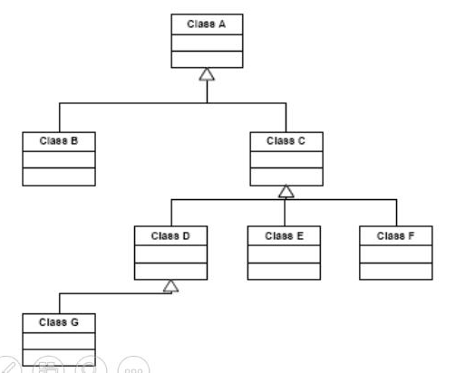
Depth of Inheritance Tree (DIT)
Another Example
DIT(A)=0
DIT(B,C)=1
DIT(D,E,F)=2
DIT(G)=3
Notes:
https://www.programmersought.com/article/64214267742/

Slide 23
Number of Children (NoC)
The number of children is the number of immediate subclasses subordinate to a class in the hierarchy.
It is an indicator of the potential influence a class can have on the design and on the system.
The greater the NoC, gives an idea of the potential influence a parent class has on design. If a class has a large number of sub-classes, it could require more testing of its methods.
The greater the NoC, the greater the reuse since inheritance is a form of reuse.
Example:
Customer has an NOC of 1.
NOC for Preferred_Customer is 0 since it is a terminating or leaf node in the tree structure.

Slide 24
Number of Children (NoC)
Another Example
NoC(A)=2
NoC(C)=3
NoC(D)=1
NoC(B,E,F,G)=0

Slide 25
Coupling Between Objects (CBO)
CBO metric therefore is a measure of non inherited interactions between classes.
CBO is a count of the number of other classes to which a class is coupled.
It is measured by counting the number of distinct non-inheritance related class hierarchies on which a class depends.
Excessive coupling is detrimental to modular design and prevents reuse.
The more independent a class is, the easier it is reuse in another application.

Slide 26
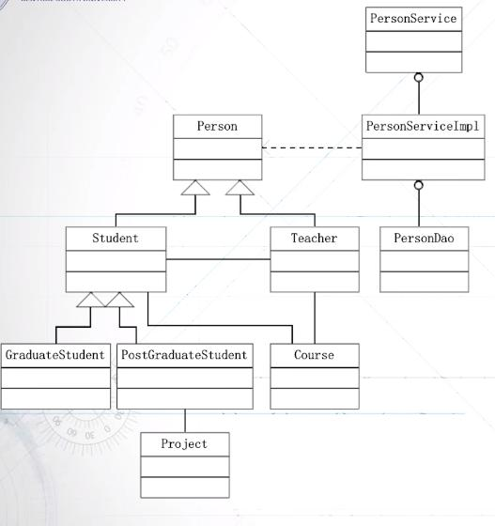
Coupling Between Objects (CBO)
Two classes may have excessive coupling (too many messages passing between them).
This implies that those classes should be combined into one class.
Example:
CBO(Student) = 2
CBO(PersonServiceImp) = 1

Slide 27
Response for a Class (RFC)
RFC is the count of the set of all methods that can be invoked in response to a message to an object of the class or by some method in the class.
This metric looks at combination of the complexity of a class through the number of methods and the amount of communication with other classes.
The larger the number of methods that can be invoked from a class through messages, the greater the complexity of the class.
Example:
RFC for Preferred_Customer = 0 (self) + 0 (Customer) + 1 (Credit_Card)
= 1

Slide 28
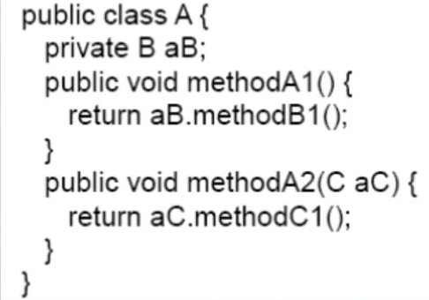
Response for a Class (RFC)
Another Example
RS(A) = { methodA1, methodA2, methodB1, methodC1 }
RFC(A) = 4

Slide 29
Lack of Cohesion (LCOM)
Lack of Cohesion (LCOM) measures the dissimilarity of methods in a class by instance variable or attributes.
If a class has different methods performing different operations on the same set of instance variables, the class has cohesion.
A highly cohesive module should stand alone; high cohesion indicates good class subdivision.
Lack of cohesion or low cohesion increases complexity, thereby increasing the likelihood of errors during the development process.
High cohesion implies simplicity and high reusability.

Slide 30
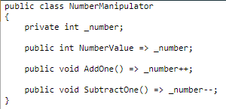
Lack of Cohesion (LCOM)
LCOM formula:
LCOM = 1 – (sum(MF)/M*F)
M is the number of methods in class (constructor, getter, setter, other methods)
F is the number of instance fields in the class.
MF is the number of methods of the class accessing a particular instance field.
Sum(MF) is the sum of MF over all instance fields of the class.
The LCOM takes its values in the range [0-1]
LCOM = 1 – (sum(MF)/M*F)
= 1 – ¾
= 0.25
Notes:
https://www.ndepend.com/docs/code-metrics
https://blog.ndepend.com/lack-of-cohesion-methods/

Slide 31
Interpretation
Metric | Objective
Cyclomatic Complexity | Low
LOC / Executable Statements | Low
Comment percentage | ~ 20 - 30 %
Weighted Method per Class (WMC) | Low
Response for a Class (RFC) | Low
Lack of Cohesion of Methods (LCOM) Cohesion of Methods | Low High
Coupling Between Objects (CBO) | Low
Depth of Inheritance Tree (DIT) | Low (Trade off)
Number of Children (NoC) | Low (Trade off)

Slide 32
Other Metrics
Lines of Code (LOC)
Project LOC= Import’s + Classes LOC
Class LOC= Class Declaration + Variable Declarations + Methods LOC + Inner (sub) Classes LOC
Method LOC= Method Declaration + Local Variable Declarations + Statements
Average Methods Per Class
= (Total no. of methods) / (Total no. of classes)
The number of methods and the complexity of methods involved is an indicator of how much time and effort is required to develop and maintain a class.
Classes with large numbers of methods are likely to be more application specific, limiting the possibility of reuse.

Slide 33
Depth of Inheritance Tree
The deeper a class in the hierarchy, the greater the number of methods it is likely to inherit, hence, more complex behaviour.
Deeper trees constitute greater design complexity, since more methods and classes are involved. The deeper a particular class is in the hierarchy, the greater the potential reuse of inherited methods.
Inheritance Tree Depth = Max Inheritance Tree Path Length

Slide 34
Degree of Reuse of Inheritance Methods
Simply defining methods in such a way that they can be reused via inheritance does not guarantee that those methods are actually reused.
Percent of Potential Method Uses Actually Reused (PP):
PP =
Total no. of Actual Method Uses
Total no. of Potential Method Uses
Percent of Potential Method Uses Overridden (PM):
_{PM =} Total Number of Methods Overridden Total no. of Potential Method Uses

Slide 35
Other Metrics
An application constructed with more finely granular objects (i.e. a lower number of functions per object) is likely to be more easily maintained because objects should be smaller and less complex.
More finely granular objects should also be more reusable.
Application Granularity = ^{Total Number of Objects}
Total Function Points

